Slide 1
Shadowed Segment Maps and Patterns Detection of Bus lines in Beer Sheva
Liad Nahmias
E-mail: liadn@post.bgu.ac.il
Prof. Noam Tractinsky, Department of Information Systems Engineering
Dr. Peter Bak, Department of Industrial Engineering and Management
Notes:
A comprehensive review of how Singapore developed into one of the best transport network
Insights into direction of future planning
Introduction to a research area for collaboration

Slide 2
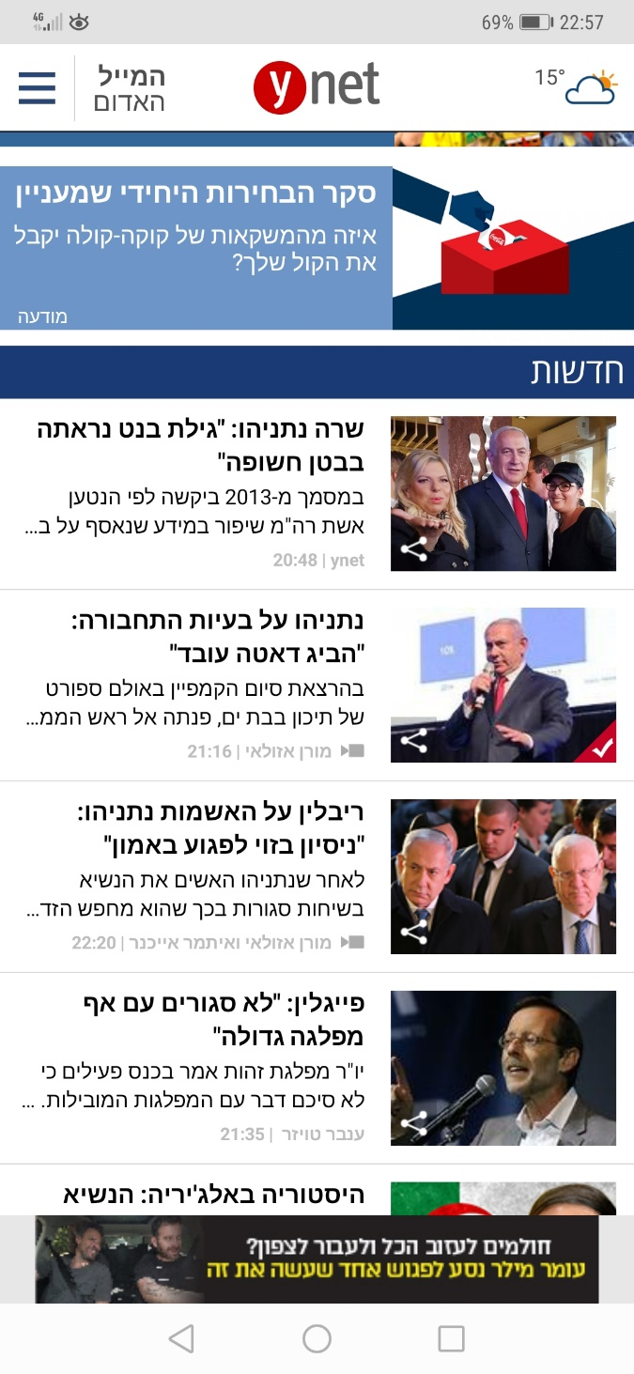
Motivation
‘… By estimations, if 10% of private car drivers switched to using public transportation, it would be enough to improve the massive traffic jams on Israel’s roads.’ Speakers at the 58th Israeli Geographic Association conference, December 2017
Figure 1: Ynet app on 02.04.19
Notes:
The public transportation system serves a vital role in modern life.
It facilitates the movement of masses of people from one place to another, in relatively quick, cheap, and easy ways.

Slide 3
Proposal Purpose
This proposal is aimed at providing a means for monitoring the public transportation system and planning schedules by understanding the true picture on the roads (delays, number of passengers between stops, etc.).
Metro Maps
Comparison
+
Planned vs Actual/s
Planned vs Average
Actual/s vs Average
+
No Using Map
Figure 2: Montreal metro map. http://www.stm.info/sites/default/files/pictures/a-plan_metro_noir.pdf
Notes:
montreal

Slide 4
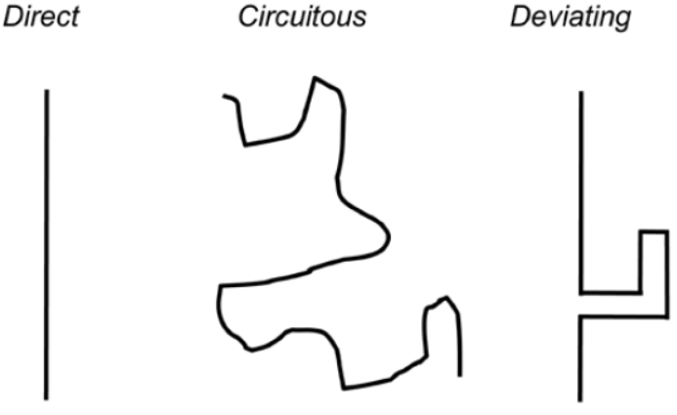
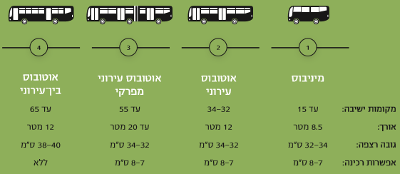
Public Transportation
[Walk12] defined “Public Transportation” as consisting of "regularly scheduled vehicle trips, open to all paying passengers with the capacity to carry multiple passengers whose trips may have different origins, destinations and purposes” ([Walk12] p. 13-14).
Figure 3: Three possible types of lines. (From [Walk12] P.48)
Figure 4: The four types of buses in Israel. (From [IsIA16] P.37)

Slide 5
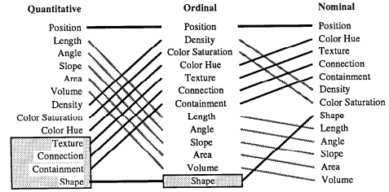
Visualization
“Computer-based visualization systems provide visual representations of datasets designed to help people carry out tasks more effectively.” (Tamara Munzner [Munz14] P.1).
Figure 5: Mackinlay's model for encoding all three type of raw data (Nominal, Ordinal and Quantitative). The gray parts were found as ineffective. (From [Mack86] P.18)

Slide 6
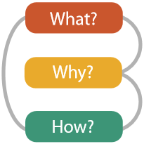
Visualization
What data we have and how to classify it to its different types [Datasets, Attributes ]
Why a visualization was chosen for this task [User Tasks]
How to create the visualization [Data Encoding/Manipulation]
Figure 6: Mackinlay's model for encoding all three type of raw data (Nominal, Ordinal and Quantitative). The gray parts were found as ineffective. (From [Mack86] P.18)

Slide 7
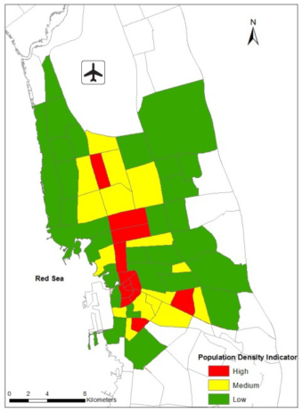
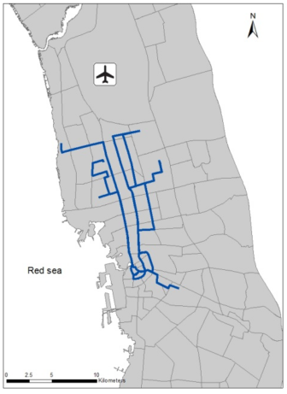
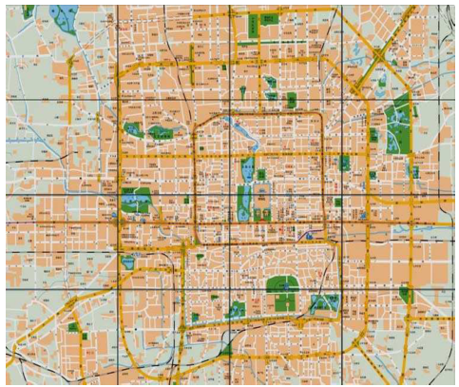
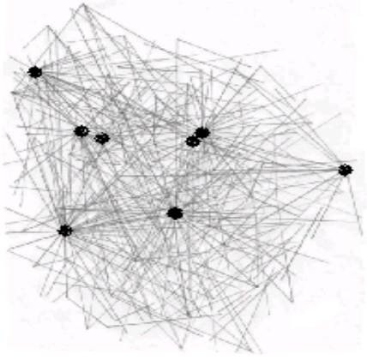
Related Work
Spatially-based Visualizations
Network-based Visualizations
Figure 7+8: Mackinlay's model for encoding all three type of raw data (Nominal, Ordinal and Quantitative). The gray parts were found as ineffective. (From [Mack86] P.18)
Figure 9+10: Beijing public transportation map into graph. The black nodes are the hubs (Central stations). (From [WuGS04] P.4)

Slide 8
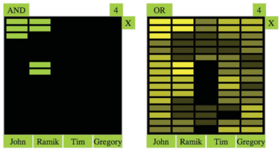
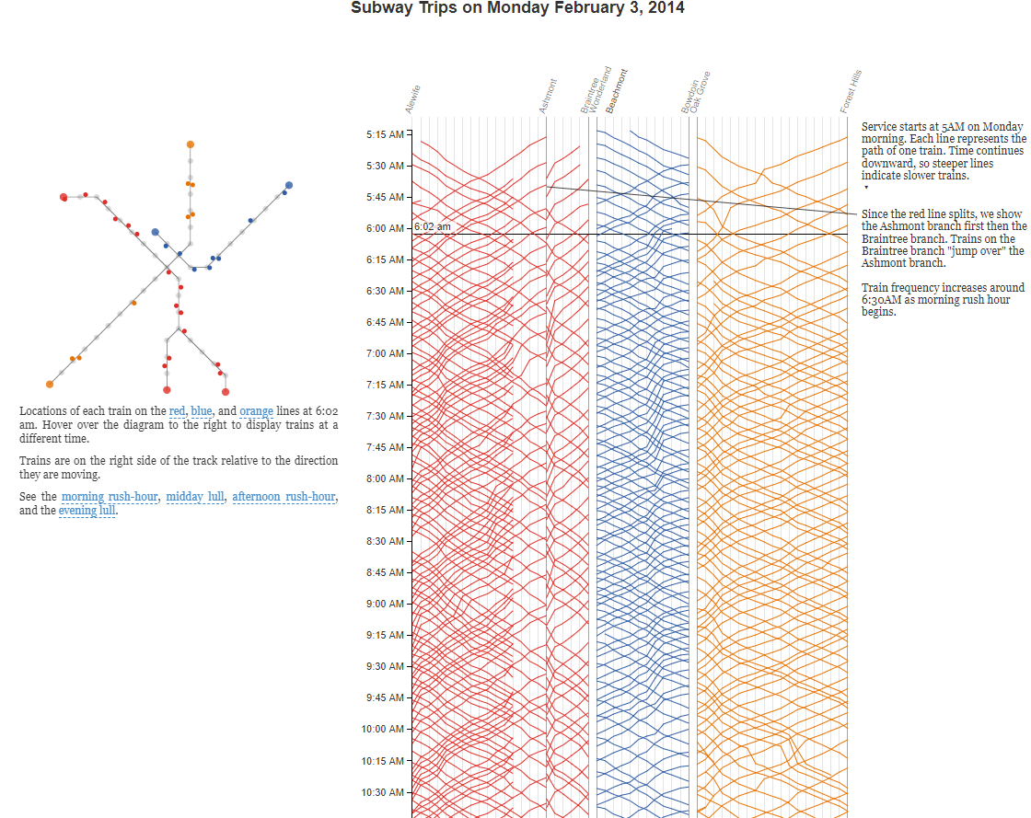
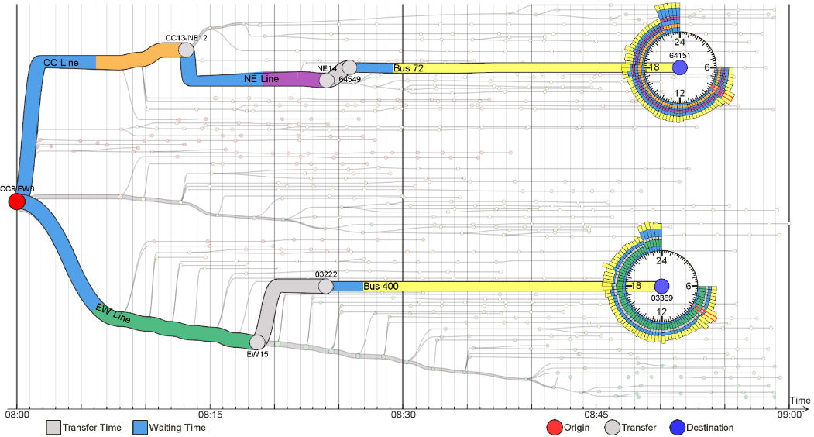
Related Work
Data-encoded
Examples
Figure 11+12: OnSet visualization matrices. (From [SMDS14] P.6)
Figure 13: The visualization of the MBTA data
Figure 14: OD visualization options from origin stop CC9/EW8 to two destination stops (64151 and 03369). ((From [ZFAE14] P.3)
Notes:
13 - Boston’s Massachusetts Bay Transit Authority (MBTA)
14 - singapore

Slide 9
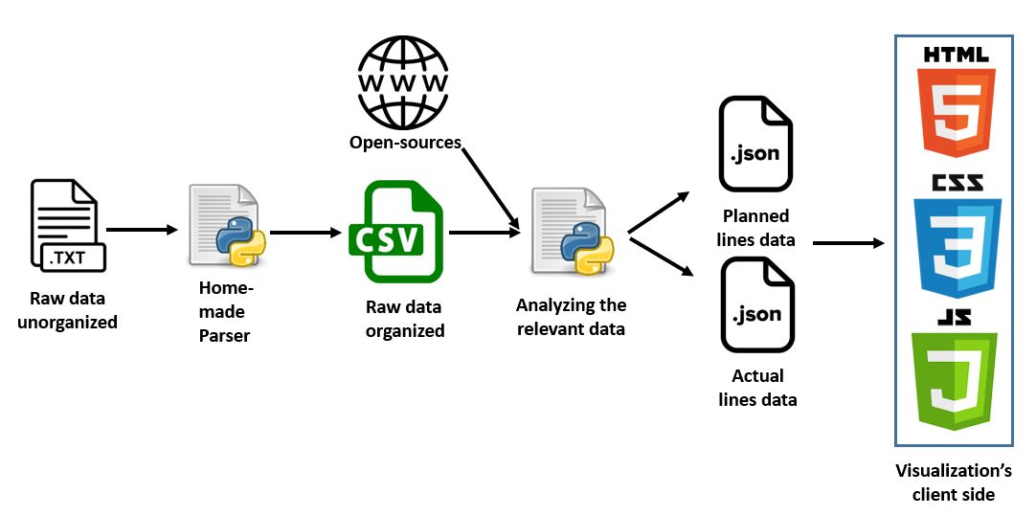
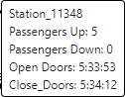
What - Data Processing
33 unique bus lines, e.g., 2, 3A, 81.
65 unique routes, e.g., '81': ['9269399','9271551']
577 unique stops
748 unique segments (a part of the road between two neighboring stops)
16,929 trips (Real-time data on a specific route) during a week.
Figure 15: The Whole Data processing

Slide 10
Why – Main User Tasks
Delay in Trip, segment and stop
Comparison (Planned vs. Actual, Planned vs. Actuals, Actual vs. Actuals)
Most used stop in trip (board/alight)
Crowded segments
Long-tail trips
Number of stops the bus had stopped
Average speed
Earlier trip from planned and latest arrival
Daily, weekly and monthly reports
Define Patterns for planning

Slide 11
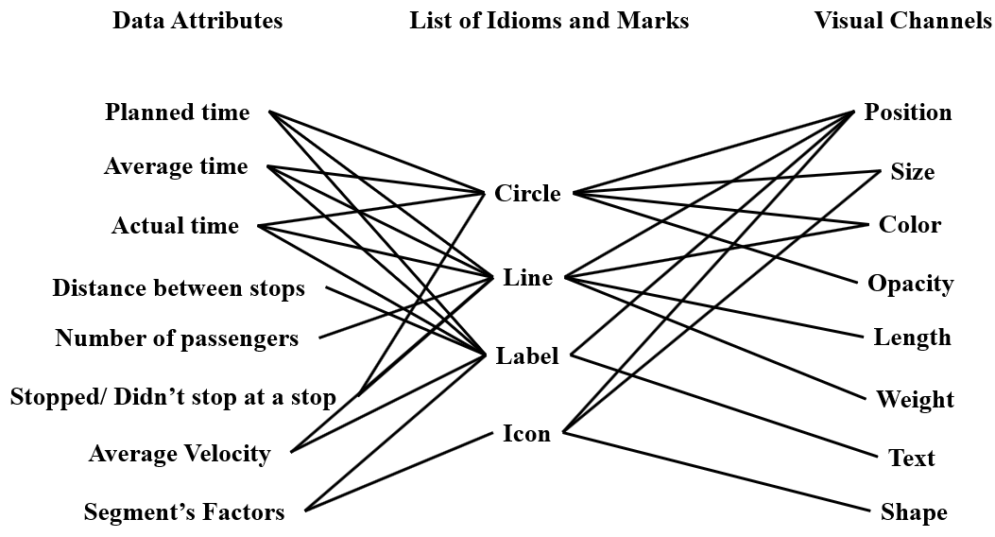
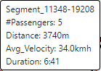
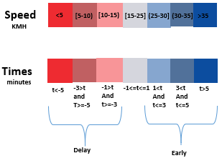
How – Shadowed Segments Maps
Figure 16: The Possible design space
Figure 17: Visualization “Hide data”
Figure 18: Visualization color palette

Slide 12
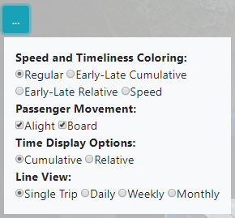
How – Shadowed Segments Maps
Figure 19: Visualization’s Menu

Slide 13
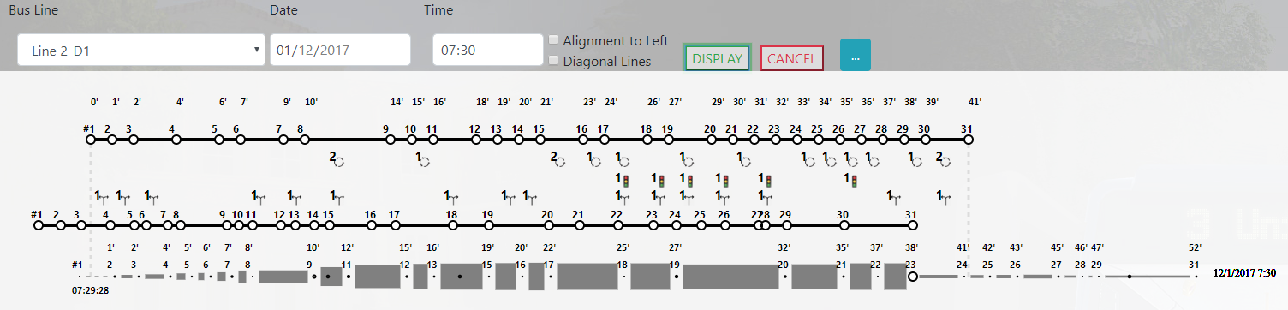
Example 1 – Main
Figure 20: Line 2_D1 Single trip on 01.12.17 07:30

Slide 14
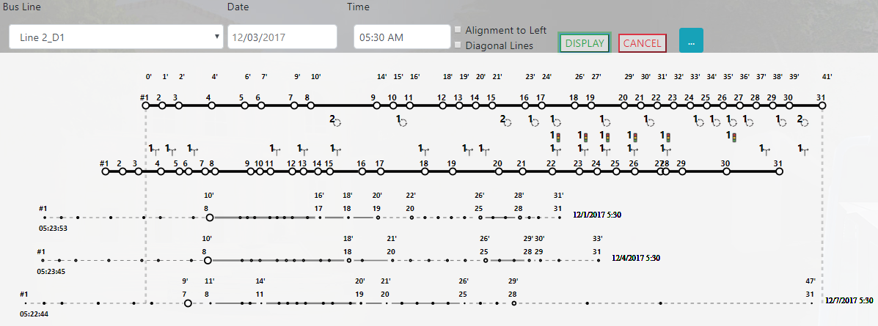
Example 2 – Long Tails
Figure 21: Line 2_D1 Monthly Report 05:30. pay attention for the long tails between stops 1 to 8

Slide 15
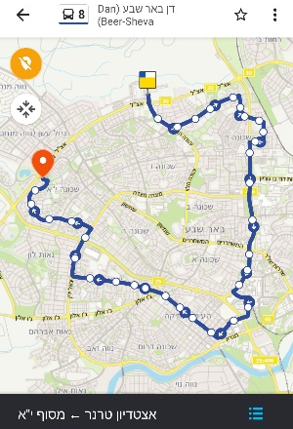
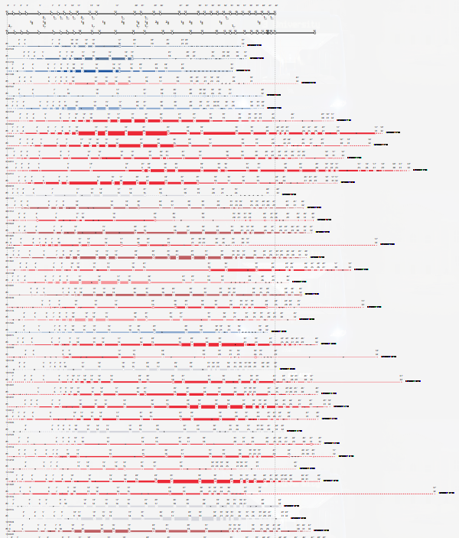
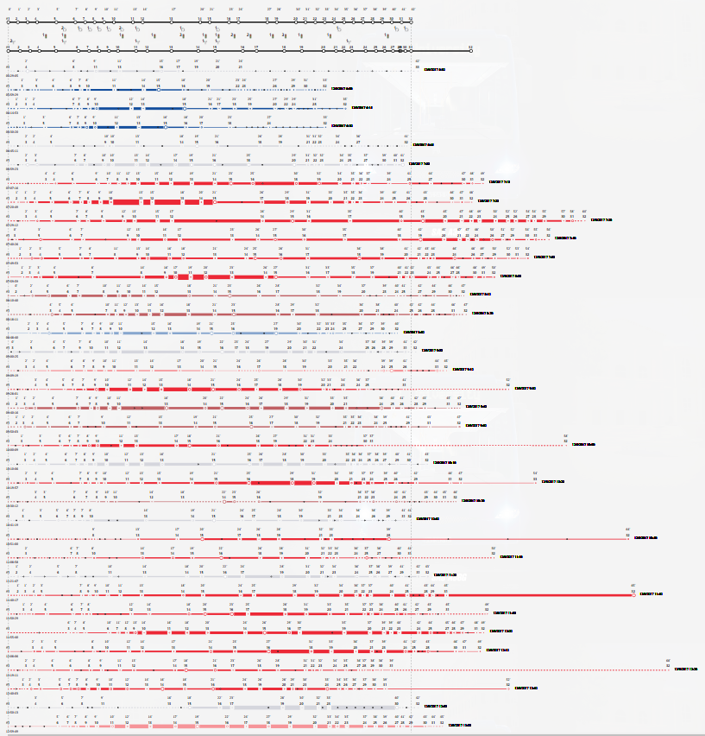
Example 3 – Planning
Line 8_D1 (32 stops)
Figure 22: Line 8_D1 Moovit
Figure 23: Line 8_D1 03.12.17 (Sunday) 05:30-13:00
Figure 24: Line 8_D1 05.12.17 (Tuesday) 05:30-13:00

Slide 16
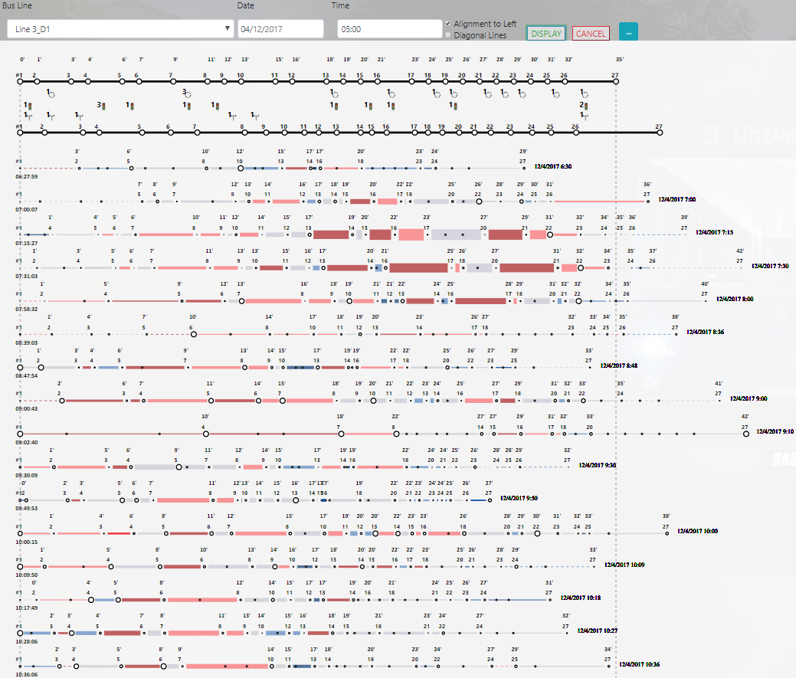
Example 4 – Speed
Figure 25: Line 3_D1 04.12.17 (Monday) Daily Report. Pay attention to Segments 5-7 and 13-14

Slide 17
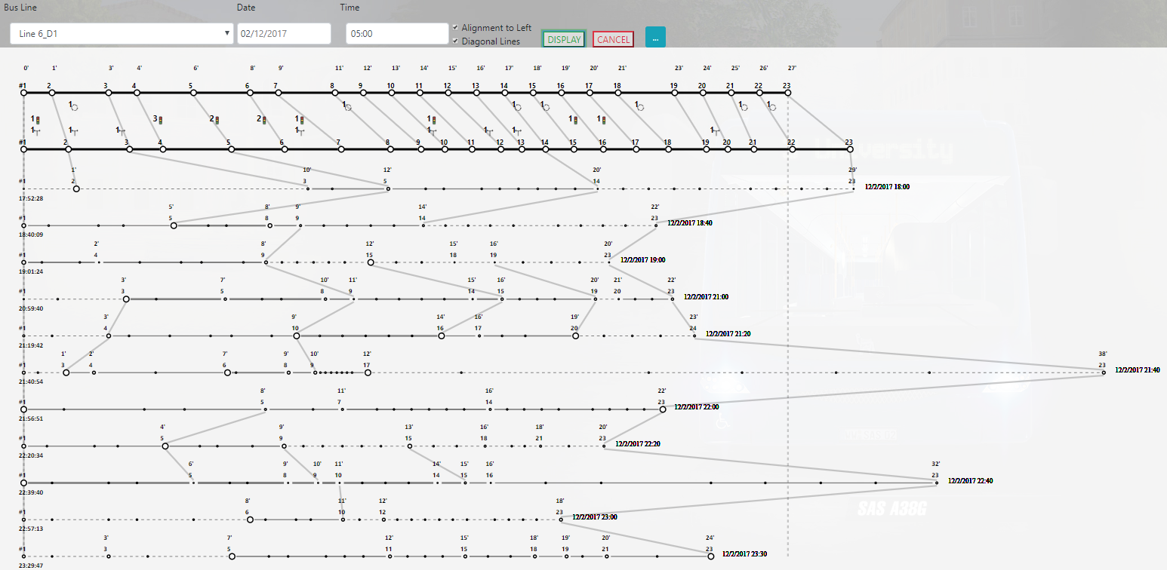
Example 5 – Curtains
Figure 26: Line 6_D1 02.12.17 (Saturday) Daily Report

Slide 18
Experts Review
Seven experts participated in our experts' review interview
The interview for this project included:
Personal introduction
Short introduction of the visualization
Two pilot tasks (16 questions)
Free time with the visualization
Final survey
Figure 27: Histogram of participants by gender
Figure 28: Histogram of participants by workplaces

Slide 19
Results
Figure 29: Histogram of usefulness of the visualization
Figure 30: Histogram of willing to work with the visualization
Figure 31: Histogram of the opinion of the lack of map
Figure 32: Histogram of the opinion of the average line feature

Slide 20
Experts Comments
“The speed component does not exist in the current systems” Expert 3
“The "curtains" of stops are very good, but I believe that 90% of the users will find them unclear” Expert 4
“The visualization in its current status can be used as a tool for verifying public complaints regarding delays and other problems in the bus lines”
Expert 3 & Expert 4
“The comparison by times and not by distances is really good. It’s easy to see if there is delay or an early arrival” Expert 6
“The lack of use of a geographic map renders the system unusable. I personally did not like the system at all”
Expert 1

Slide 21
Future Work
Adjusting for other places would require a short data collection session
The future infrastructure of the visualization system must include new methods such as node.js, which enable faster loading of big data
In order to create a full and correct baseline, opening and closing the bus doors when arriving at a stop and when leaving it, respectively, should be mandatory
Show faded out trips on the schedule we do not have specific data from the ministry of transportation

Slide 22
References
[AABK71] Andrienko, Gennady ; Andrienko, Natalia ; Bak, Peter ; Keim, Daniel ; Wrobel, Stefan: Visual Analytics of Movement. Bd. 1, 1871 — ISBN 978-85-232-0700-7
[Aljo14] Aljoufie, M.: Spatial analysis of the potential demand for public transport in the city of Jeddah, Saudi Arabia. In: WIT Transactions on the Built Environment Bd. 138 (2014), S. 113–123 — ISBN 9781845647780
[Carp08] Carpendale, Sheelagh: Evaluating information visualizations. In: Lecture Notes in Computer Science (including subseries Lecture Notes in Artificial Intelligence and Lecture Notes in Bioinformatics) Bd. 4950 LNCS (2008), S. 19–45 — ISBN 354070955X
[ClYo14] Claudio, Pio ; Yoon, Sung Eui: Metro transit-centric visualization for city tour planning. In: Computer Graphics Forum Bd. 33 (2014), Nr. 3, S. 271–280 — ISBN 1467-8659
[ElST07] Elmqvist, Niklas ; Stasko, John ; Tsigas, Philippas: DataMeadow: A visual canvas for analysis of large-scale multivariate data. In: VAST IEEE Symposium on Visual Analytics Science and Technology 2007, Proceedings (2007), S. 187–194 — ISBN 9781424416592
[ElYi15] Elmqvist, Niklas ; Yi, Ji Soo: Patterns for visualization evaluation. In: Information Visualization Bd. 14 (2015), Nr. 3, S. 250–269
[IsIA16] Israel, Public Transportation Department ; Israel, Public Transportation Authority ; Ashak, Robert: Instructions for Planning and Operating The buses in Israel, 2016

Slide 23
References
[ [LBIP12] Lam, Heidi ; Bertini, Enrico ; Isenberg, Petra ; Plaisant, Catherine ; Lam, Heidi ; Bertini, Enrico ; Isenberg, Petra ; Plaisant, Catherine ; u. a.: Empirical Studies in Information Visualization : Seven Scenarios To cite this version : Empirical Studies in Information Visualization : Seven Scenarios. In: IEEE Transactions on Visualization and Computer Graphics Bd. 18 (2012), Nr. 9, S. 1520–1536
[Mack86] Mackinlay, Jock: Automating the design of graphical presentations of relational information. In: ACM Transactions on Graphics Bd. 5 (1986), Nr. 2, S. 110–141 — ISBN 1558605339
[Munz09] Munzner, Tamara: A Nested Model for Visualization Design and Validation (2009)
[Munz14] Munzner, Tamara: Visualization Analysis and Design, 2014 — ISBN 9781466508934
[SMDS14] Sadana, Ramik ; Major, Timothy ; Dove, Alistair ; Stasko, John: OnSet: A visualization technique for large-scale binary set data. In: IEEE Transactions on Visualization and Computer Graphics Bd. 20 (2014), Nr. 12, S. 1993–2002 — ISBN 10.1109/TVCG.2009.122
[Syrj16] Syrjärinne, Paula: Urban Traffic Analysis with Bus Location Data, 2016 — ISBN 9789520300685
[ToMö05] Tory, Melanie ; Möller, Torsten: Evaluating Visualizations : Do Expert Reviews Work ? Graphics, Usability and Visualization Lab When formal user studies fail. In: IEEE computer graphics and applications Bd. 25 (2005), Nr. 5, S. 8–11

Slide 24
References
[Tuft08] Tufte, Edward R: The visual display of quantitative Information. In: The Visual Display of Quantitative Information (2008) — ISBN 9780961392147
[Walk12] Walker, Jarrett: Human Transit, 2012 — ISBN 9781597269711
[WuGS04] Wu, Jianjun ; Gao, Ziyou ; Sun, Huijun: Urban transit system as a scale--free network. In: Modern Physics Letters B Bd. 18 (2004), S. 1043–1049
[ZFAE14] Zeng, Wei ; Fu, Chi Wing ; Arisona, Stefan Muller ; Erath, Alexander ; Qu, Huamin: Visualizing mobility of public transportation system. In: IEEE Transactions on Visualization and Computer Graphics Bd. 20 (2014), Nr. 12, S. 1833–1842 — ISBN 1077-2626 VO - PP
[ZhWS17] Zhuge, Xu ; Wang, Hao ; Strazdins, Girts: Evaluating the data visualization for demanding marine operations. In: Techno-Ocean 2016: Return to the Oceans (2017), S. 471–477 — ISBN 9781509024452

Slide 25
Questions?
Url: http://proj.ise.bgu.ac.il/liadn/Bus_stops_Weekly.html
E-mail: liadn@post.bgu.ac.il

